Slide 1
Optimizing Water Management Using LoRaWAN-
Enabled IoT Framework and Behavioural Analysis
Guide
Dr. D.Manivannan
Associate Dean (Infrastructure) / Professor, SoC
SASTRA Deemed University
126003101-Harish T
126003093-Guru Prasath M
126003184-Nishanth M V

Slide 2
Agenda
Motivation
Objective
Base Paper
Problem Statement
Literature survey
Modules
Dataset
Model Implementation
Hardware Setup
Hardware Encodings
Demonstration
References

Slide 3
Motivation
Sustainable water consumption is crucial for efficient resource management in a large water distribution network
Traditional water management methods fail to provide real-time insights into consumption patterns, leading to waste, overuse, and resource misallocation
This project presents the water consumption behaviour on a university campus using an IoT framework integrated with LoRaWAN for high-resolution data acquisition

Slide 4
Objective
To develop an IoT-based smart water management system using LoRaWAN technology.
To monitor real-time water consumption and analyze behavioral patterns.
To provide data-driven insights for optimizing water distribution and reducing wastage.

Slide 5
Base paper
•Title: Behavioural Analysis of Water Consumption using IoT-based Smart Retrofit Meter
•Authors: Kumar Lall et al.
•Journal: IEEE Access (Volume:12), 2024
•Indexed In: IEEE Xplore
•DOI: 10.1109/ACCESS.2024.3436889

Slide 6
Problem Statement
Traditional water management lacks real-time monitoring and predictive analytics.
Manual tracking leads to inefficiencies, high costs, and water wastage.
Need for an efficient, low-power, scalable IoT framework for continuous data collection and analysis.

Slide 7
Literature survey
Category | Study/Author | Key findings | Limitations
IoT-Based Smart Water Meters | Arsene et al. (2022)【22】 | K-means clustering for household water consumption analysis | Limited accuracy in pattern recognition
 | Narayanan et al. (2020)【23】 | LSTM, ARIMA models for water demand forecasting | Works mainly for continuous water supply (CWS)
 | Fuentes & Mauricio (2020)【27】 | IoT-based water consumption measurement using cloud | No behavioral analysis of users

Slide 8
Literature Survey
Image-Based Meter Reading | Son et al. (2019)【2】 | CNN-based gas meter reading (85.71% accuracy) | Low accuracy, needs better feature extraction
 | Barreto et al. (2020)【3】 | YOLOv3-based model for water meters (96% accuracy) | Varying lighting conditions affect accuracy
 | Laroca et al. (2021)【24】 | Robust image-based meter reading (99% accuracy) | Manual intervention required for data correction
Water Consumption Pattern Analysis | Gurung et al. (2014)【11】 | Smart meters for water network modeling in Australia | Focuses only on CWS systems
 | Nguyen et al. (2018)【12】 | High-frequency water data analysis for urban supply | Not applicable to intermittent water supply (IWS)
 | Pesantez et al. (2020)【13】 | Smart meter data for demand forecasting | Lacks real-time behavioral analysis

Slide 9
Literature Survey
IoT & Deep Learning for Water Management | Naim et al. (2021)【26】 | AI-based automated water meter data collection | Requires high infrastructure setup
 | Herath (2019)【25】 | Smart Water Buddy for leakage detection | Not suitable for large-scale deployment
 | Jan et al. (2022)【8】 | IoT sensors for real-time leakage detection | Focuses on industrial settings, not households
Current Study | Kumar Lall et al. (2024) | IoT-based smart retrofit meter, DL-based digit recognition, Hamming distance-based correction, behavioral analysis in educational campus | First study analyzing IWS water usage in an academic setting

Slide 10
Modules
Module 1: Data Collection Module
LoRaWAN-enabled smart meters collect water usage data.
Module 2: Data Processing Module
Deep learning models analyze consumption patterns.
LSTM
ARIMA
GRU ( Five – Fold)
Module 3: Hardware Setup with real-time data predictions
Hardware setup integrated with DL model working in real-time

Slide 11
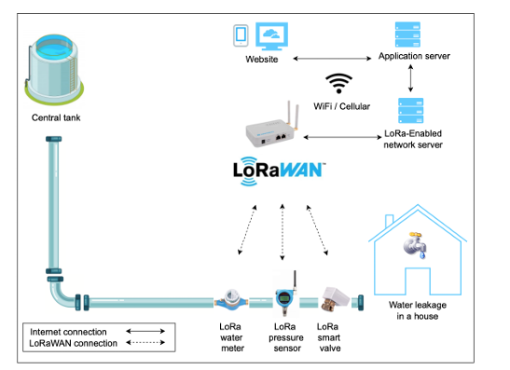
Data Collection
LoRaWAN - enabled water meters

Slide 12
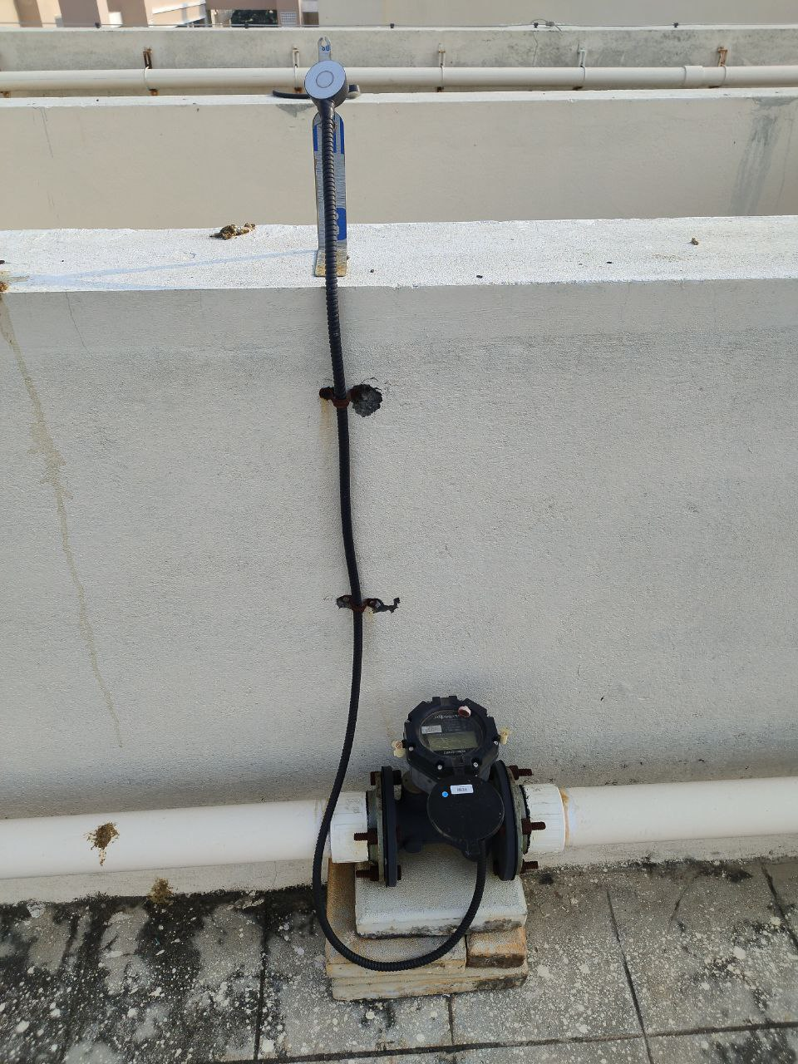
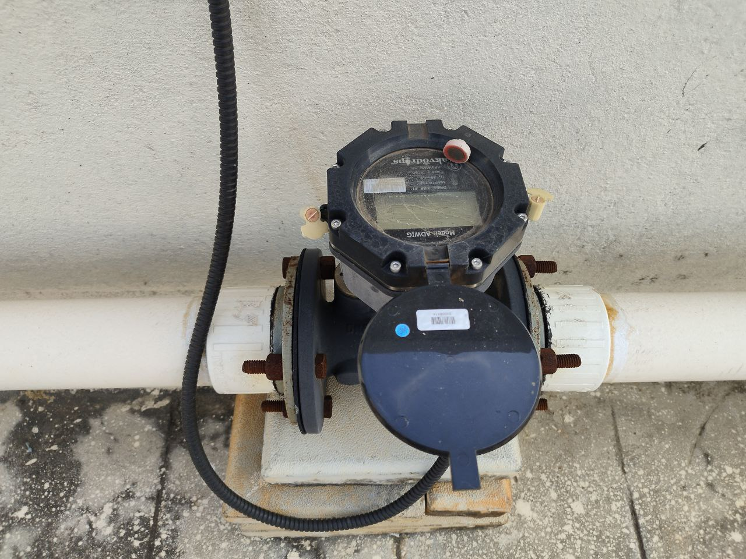
Data Collection
LoRaWAN - enabled water meters

Slide 13
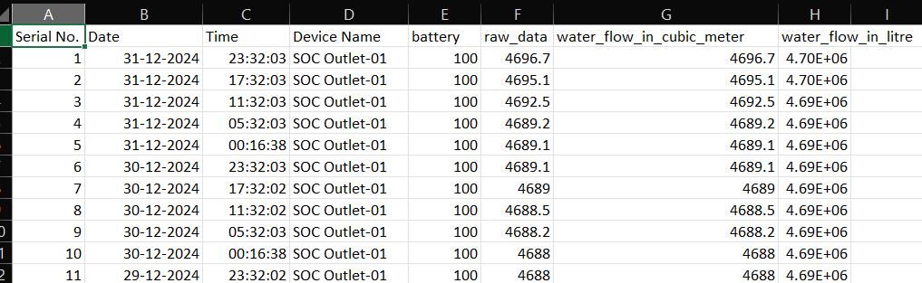
Data Set Acquired
Real-time dataset of water flow from 4 different blocks in the university
The dataset of each blocks consists of 7 attributes and 1865 instances.
There are 2 datetime attributes, 1 categorical attribute and 4 numeric attributes.

Slide 14
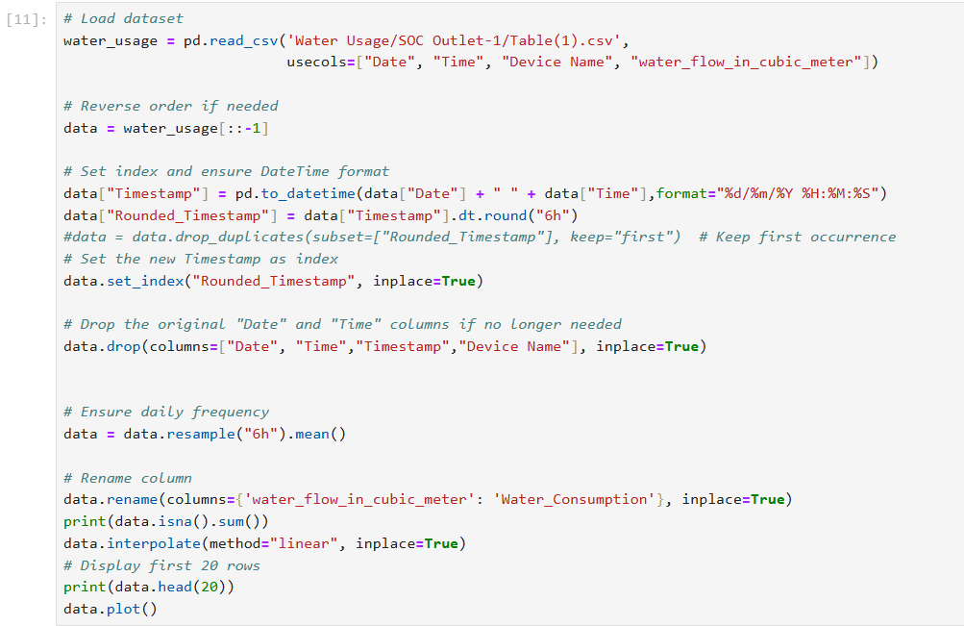
Data Preprocessing

Slide 15
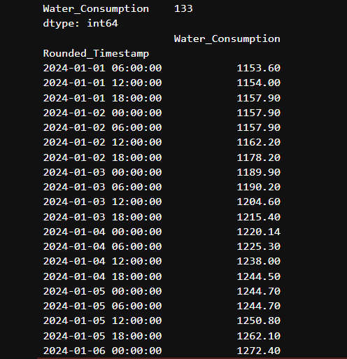
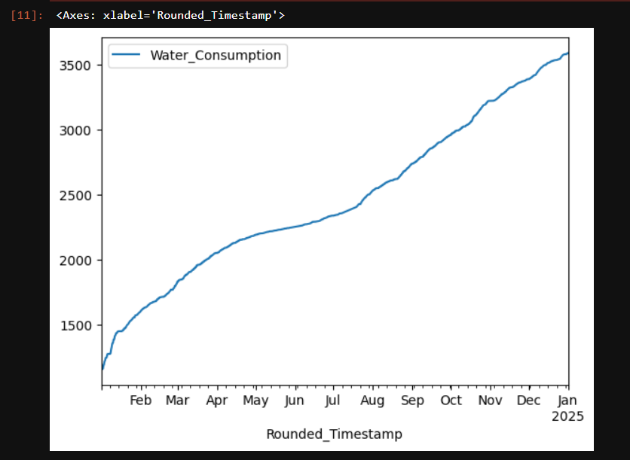
Data Preprocessing

Slide 16
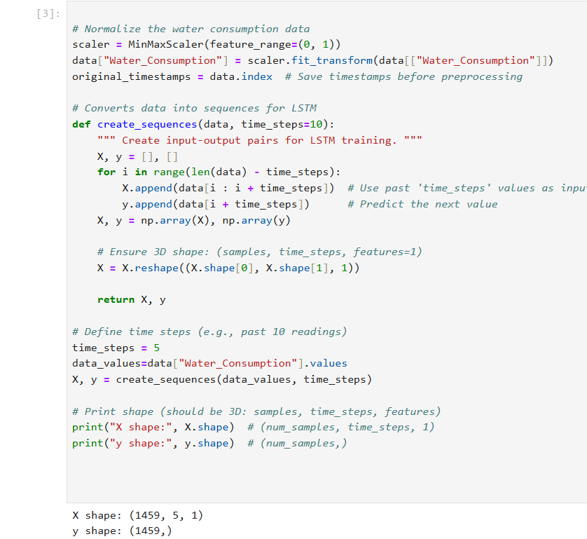
Data Preprocessing - Sequencing

Slide 17
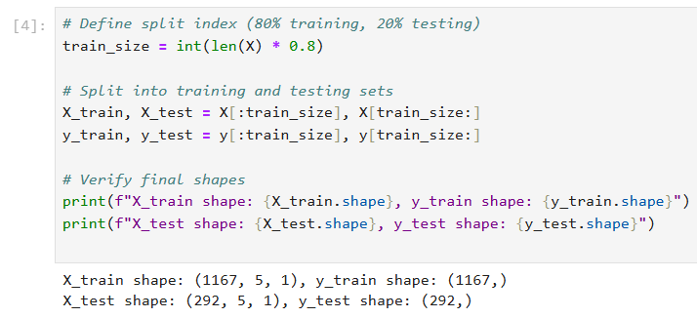
Data Preprocessing – Splitting

Slide 18
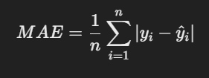

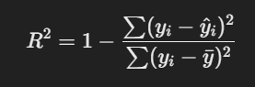
Evaluation Metrics
1. Mean Squared Error (MSE):
Measures the average absolute difference between actual and predicted values.
Lower MAE = Better model.
2. Root Mean Squared Error (RMSE):
Similar to MSE but in the same unit as the target variable (water consumption).
Lower RMSE = Better predictions.
3. R² Score (Coefficient of Determination)
Measures how well the model explains variability.
R² = 1 → Perfect model
R² = 0 → Model is as good as random guess

Slide 19
Proposed Models
ARIMA (Autoregressive Integrated Moving Average):
The ARIMA model predicts a given time series based on its own past values.
It can be used for any nonseasonal series of numbers that exhibits patterns and is not a series of random events.

Slide 20
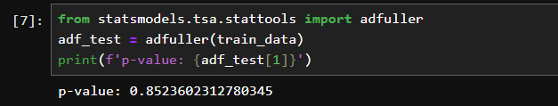
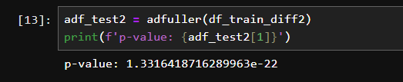
ARIMA – Removing Seasonality
In ARIMA modeling, differencing transforms non-stationary time series data into a stationary form by removing trends and making the data more stable, allowing for better forecasting.
Before differencing
After differencing twice

Slide 21
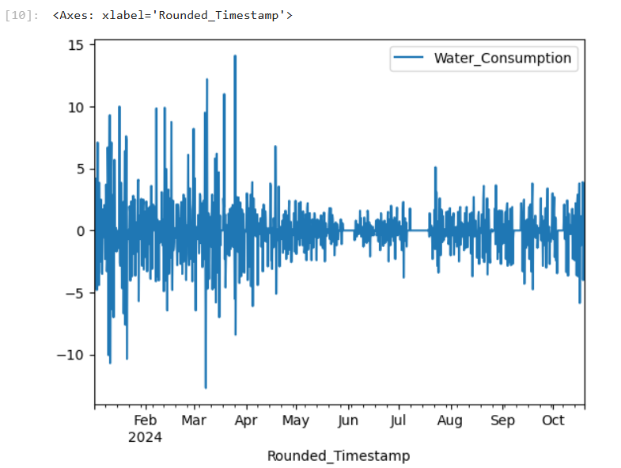
ARIMA – Removing Seasonality
In ARIMA modeling, differencing transforms non-stationary time series data into a stationary form by removing trends and making the data more stable, allowing for better forecasting.

Slide 22
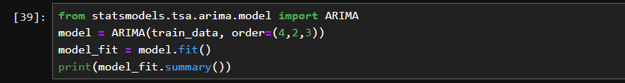
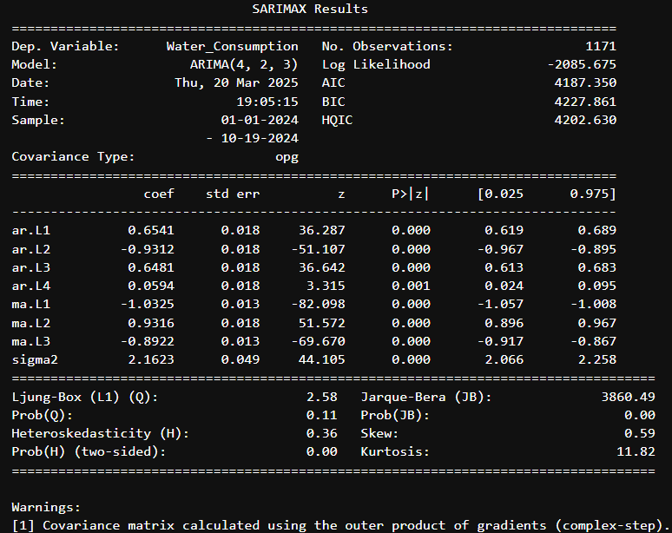
Code Snippet - ARIMA

Slide 23
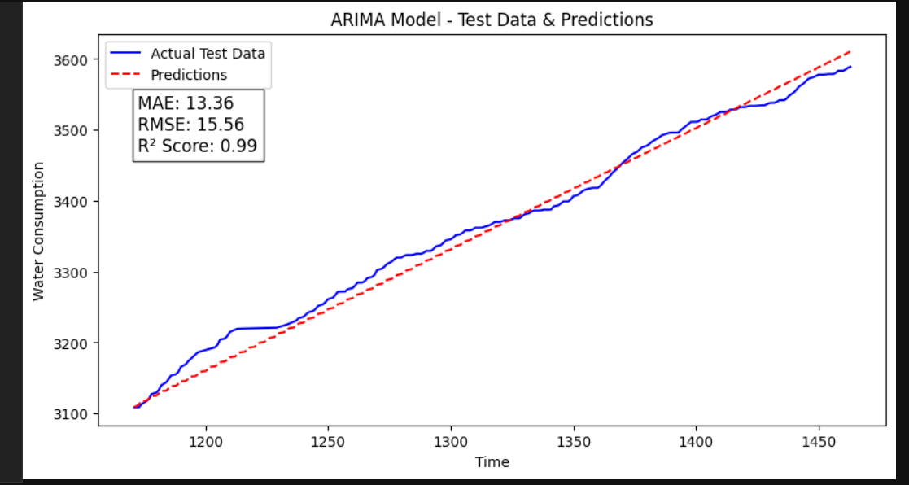
Results

Slide 24
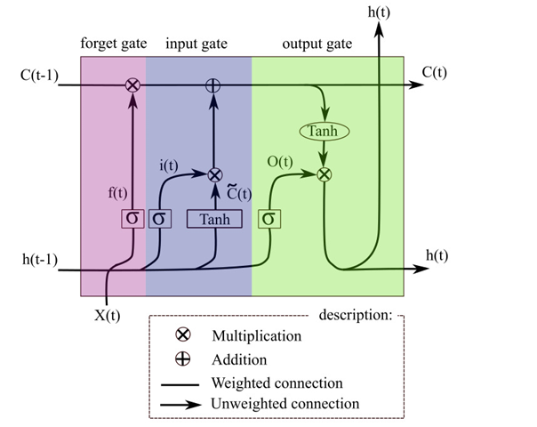
Proposed Models
Long Short-Term Memory (LSTM):

Slide 25
Proposed Models
Long Short-Term Memory (LSTM):
It is a sequential learning model which can establish temporal correlations between a previous instant t-1 and a current instant t.
Consequently, the LSTM seems the most suitable model for forecasting consumption processes, given its ability to deduce the intrinsic daily consumption resident routines.
The LSTM is based on the Back-Propagation Through Time (BPTT) learning algorithm to calculate the weights. It is made up of units called memory blocks. Each memory block contains an “input gate”, an “output gate” and a “forget gate”.

Slide 26
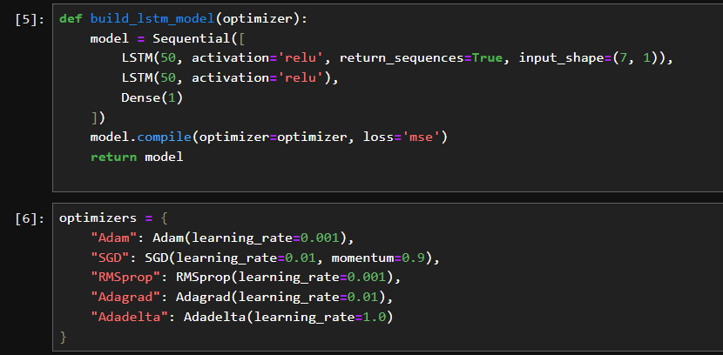
Code Snippet - LSTM

Slide 27
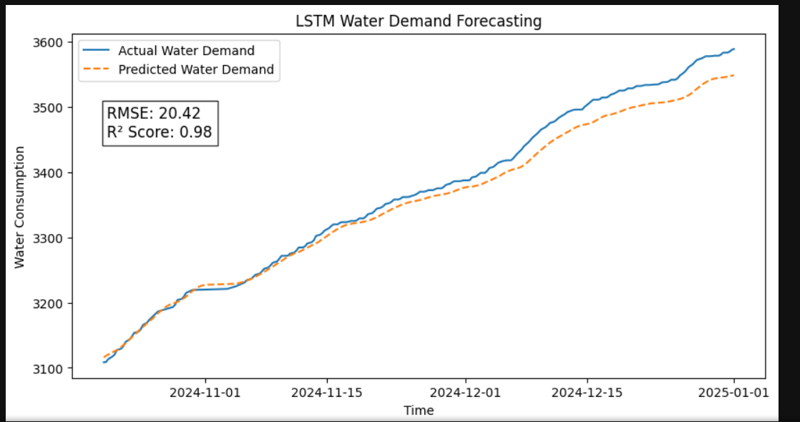
Prediction v/s Actual Plot

Slide 28
Results Using Different Optimizers
Optimizers | Parameters | RMSE / R^2 score
Adam | Learning Rate = 0.001 | RMSE – 31.03 R^2 – 0.9464
SGD | Learning Rate = 0.001, Momentum = 0.9 | RMSE – 210.67 R^2 – -1.46799
RMSProp | Learning Rate = 0.001 | RMSE – 49.10 R^2 – 0.8659
Adagrad | Learning Rate = 0.001 | RMSE – 826.84 R^2 – -37.0169
Adadelta | Learning Rate = 0.001 | RMSE – 2122.12 R^2 – -249.419

Slide 29
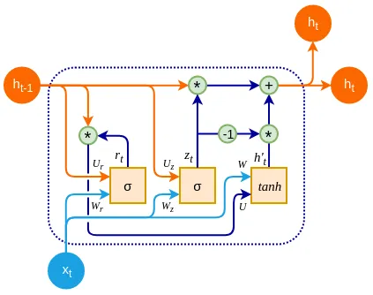
Proposed Models
GRU ( Gated Recurrent Unit ) :

Slide 30
Proposed Models
GRU ( Gated Recurrent Unit ) :
GRU is designed to model sequential data by allowing information to be selectively remembered or forgotten over time. However, GRU has a simpler architecture than LSTM, with fewer parameters, which can make it easier to train and more computationally efficient.
In GRU, the memory cell state is replaced with a “candidate activation vector,” which is updated using two gates: the reset gate and update gate.

Slide 31
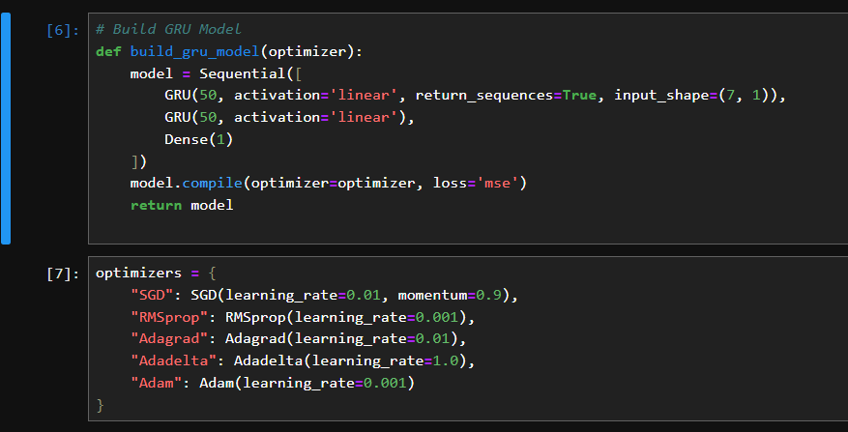
Code Snippet - GRU

Slide 32
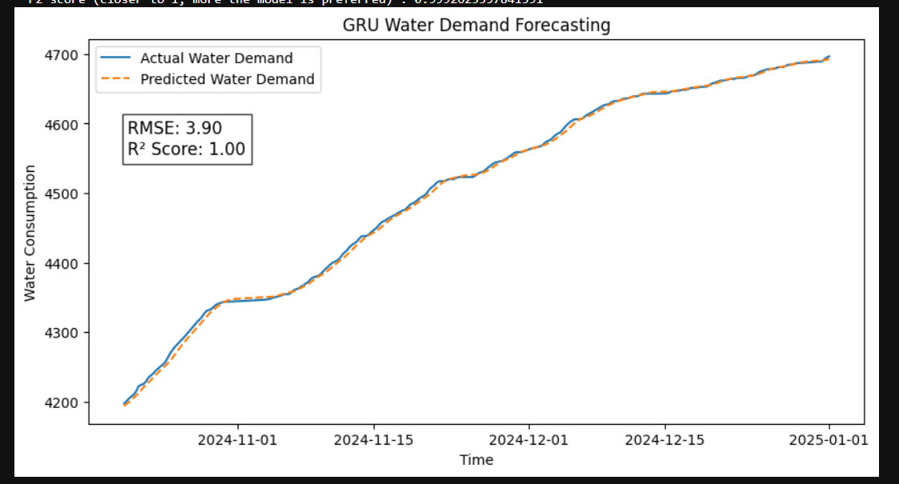
Prediction v/s Actual Plot

Slide 33
Result from different Optimizers
Optimizers | Parameters | RMSE / R^2 score
Adam | Learning Rate = 0.001 | RMSE – 4.82 R^2 – 0.998
SGD | Learning Rate = 0.001, Momentum = 0.9 | RMSE – 7.37 R^2 - 0.997
RMSProp | Learning Rate = 0.001 | RMSE – 9.97 R^2 - 0.995
Adagrad | Learning Rate = 0.001 | RMSE – 311.99 R^2 – -3.7130
Adadelta | Learning Rate = 0.001 | RMSE – 1782.78 R^2 – -152.891

Slide 34
Five-Fold GRU - Results
Folds | RMSE | R^2 score
Fold - 1 | 35.5914 | 0.9767
Fold - 2 | 5.2223 | 0.9955
Fold – 3 | 6.2640 | 0.9983
Fold - 4 | 6.8061 | 0.9977
Fold - 5 | 3.2485 | 0.9991

Slide 35
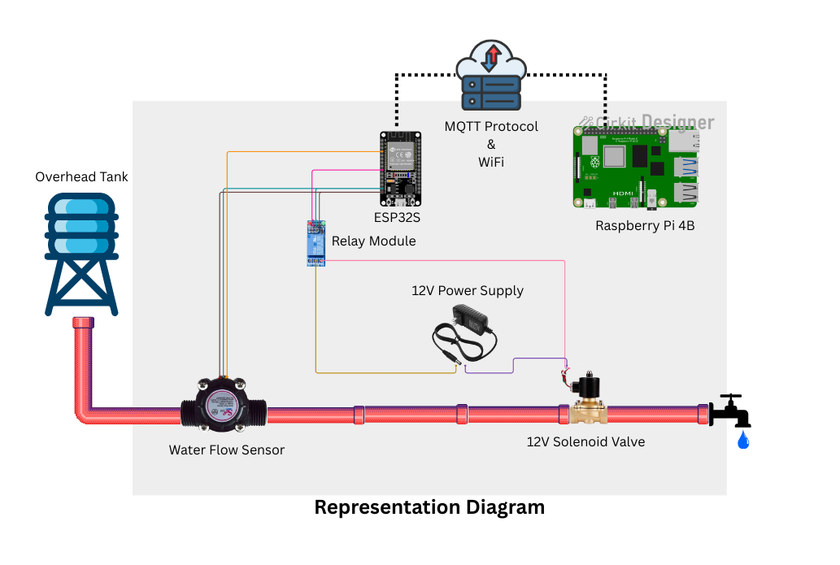
Hardware Setup

Slide 36
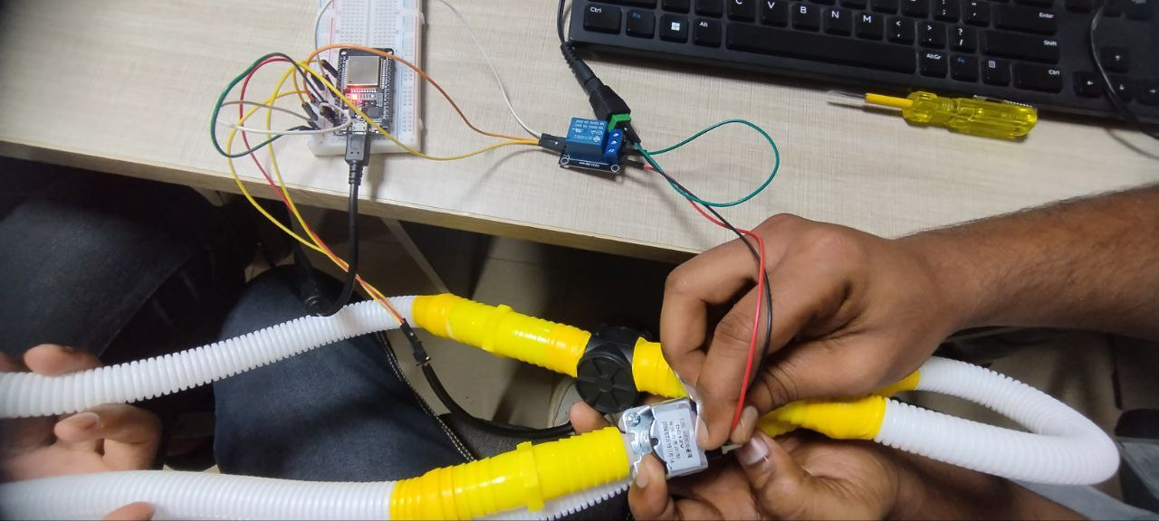
Hardware Setup

Slide 37
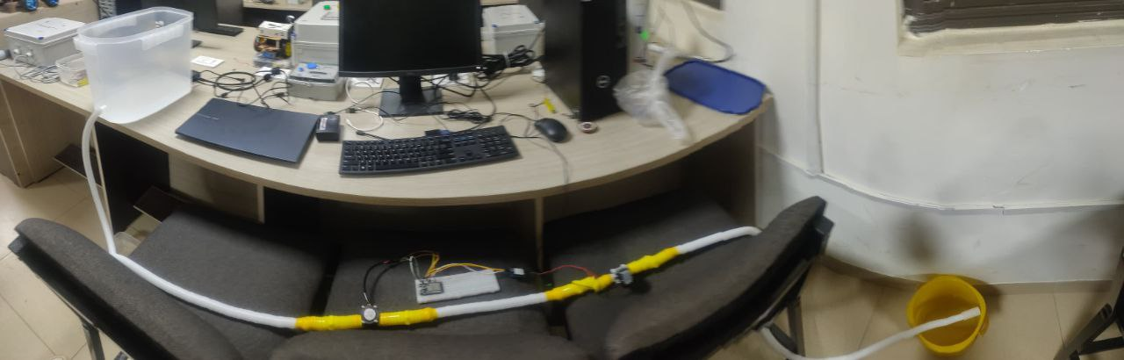
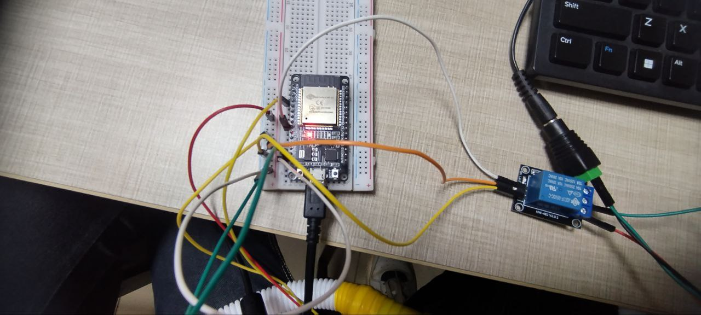
Hardware Setup

Slide 38
Hardware Setup
Water Flow Sensor
Measures water flow in real-time.
Outputs pulse signal → read by ESP32 GPIO.
ESP32
Dual-core MCU with built-in Wi-Fi & BLE.
Responsibilities:
Reads sensor data.
Sends real-time data to:
Raspberry Pi (via UART/Wi-Fi).
Adafruit IO cloud (via MQTT over Wi-Fi).
Receives control signal (e.g., sprinkler ON/OFF).
Controls relay connected to the sprinkler.

Slide 39
Hardware Setup
Relay Module
Controls high-power water pump or sprinkler.
Triggered by ESP32 GPIO.
Raspberry Pi
Mini computer running Python + GRU deep learning model.
Functions:
Receives real-time flow/level data from ESP32.
Predicts water flow using GRU model.
Compares predicted vs actual flow.
Sends ON/OFF decision to ESP32 via UART or socket.
Optional: Logs data to file or local database.

Slide 40
Hardware Setup
AdaFruit IO:
ESP32 connects to Adafruit IO over Wi-Fi using MQTT.
Features:
Real-time sensor dashboards (water flow, level).
Remote control switch (e.g., manual sprinkler ON/OFF).
Historical data graphing.
Setup:
Use Adafruit_MQTT library (Arduino IDE or MicroPython).
Feed sensor data as MQTT topics to Adafruit IO.
Use Adafruit IO Dashboards for visualization.

Slide 41
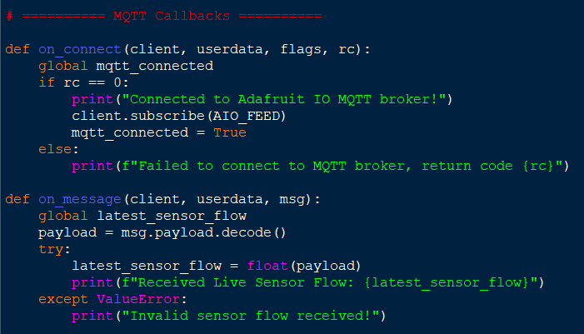
Hardware Encodings
MQTT Module:

Slide 42
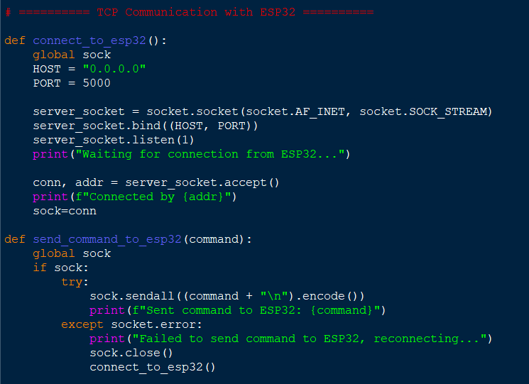
Hardware Encodings
TCP communication with ESP32:

Slide 43
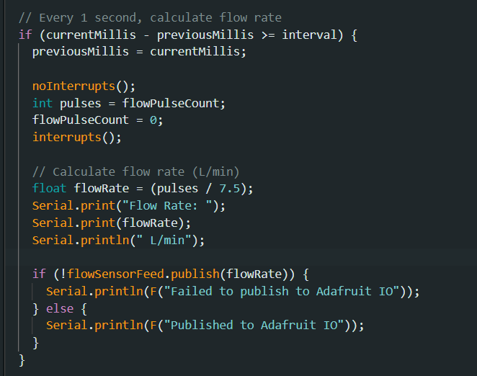
Hardware Encodings
Main Sensor Logic:

Slide 44
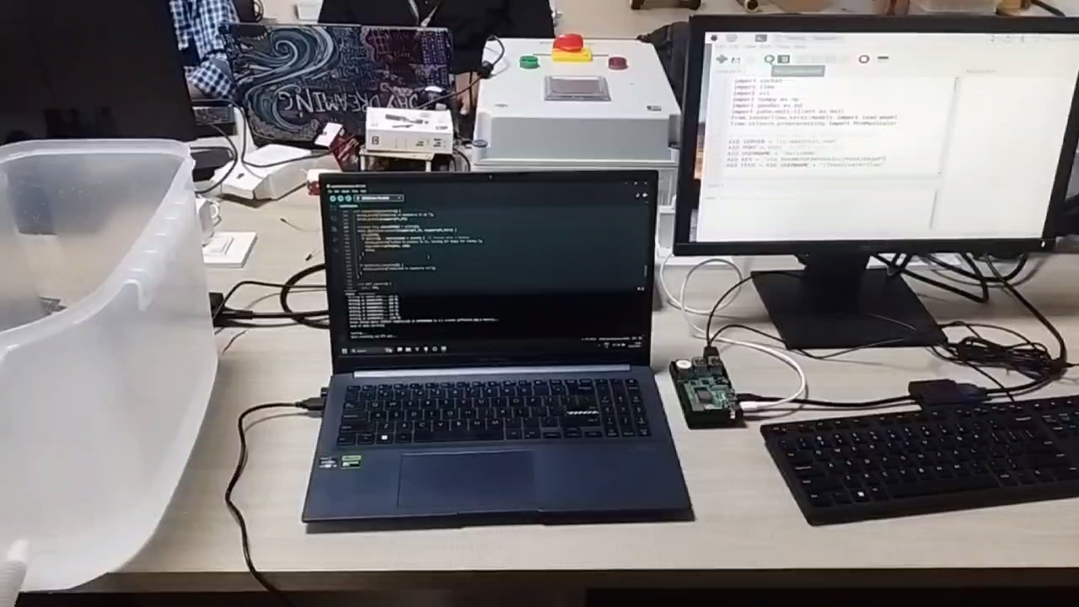
Demonstration

Slide 45
Conclusion
By leveraging real-time sensor data from water flow and processing it through a GRU-based predictive model on a Raspberry Pi, the system intelligently controls a sprinkler via an ESP32 microcontroller.
Further, the inclusion of Adafruit IO enables remote monitoring and control, providing a user-friendly interface to visualize trends and override system behavior when needed. The use of UART or Wi-Fi communication between ESP32 and Raspberry Pi ensures seamless data flow and decision execution.
The modular architecture makes it scalable and adaptable to diverse environments, and future enhancements such as LoRaWAN integration can further extend its range and deployment.

Slide 46
References
D. Li and Q. Fu, "Deep Learning Model-Based Demand Forecasting for Secondary Water Supply in Residential Communities: A Case Study of Shanghai City, China," in
IEEE Access, vol. 12, pp. 38745-38757, 2024.
A. Gil-Gamboa, P. Paneque, O. Trull, A. Troncoso, Medium-term water consumption
forecasting based on deep neural networks, Expert Systems with Applications, Volume 247, 2024.
Kim, J.; Lee, H.; Lee, M.; Han, H.; Kim, D.; Kim, H.S. Development of a Deep Learning-Based Prediction Model for Water Consumption at the Household Level. Water 2022.
Bata, M., Carriveau, R. & Ting, D.SK. Short-term water demand forecasting using hybrid supervised and unsupervised machine learning model. Smart Water 5, 2 (2020).

Slide 47
Thank you

